Slide 1
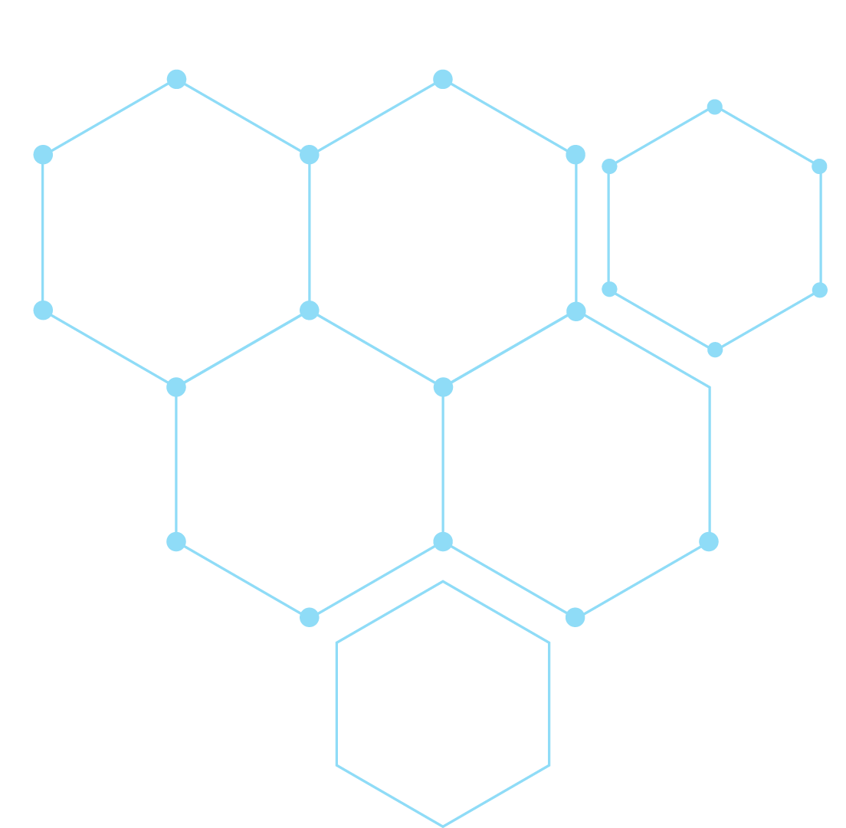
Classification of Key Risk Factors for Alzheimer's From Questionnaire Data
Leah Zhang and Victoria Zhang
Period 4

Slide 2
Table of contents
01
02
03
04
05
06
Objectives
Background
Preprocessing
Attribute Selection
Results + Analysis
Conclusion

Slide 3
01
Project Objective

Slide 4
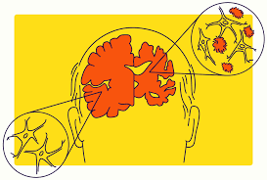
Alzheimer’s Disease
“...a general term for memory loss and other cognitive abilities serious enough to interfere with daily life” (Alzheimer’s Association).
not a normal part of aging
no known cure
if no medical breakthrough is made, 13.8 million Americans could have Alzheimer’s by 2060 (NIH)
Image source: Alzheimer's Disease Causes, Symptoms, Treatments
Notes:
Alzheimer's Disease Causes, Symptoms, Treatments
2023 Alzheimer's disease facts and figures - PubMed

Slide 5
Objective: To categorize results from a telephone questionnaire into six risk factors for Alzheimer’s.

Slide 6
02
Background

Slide 7

Datasource
Collected from questionnaire by the Behavioral Risk Factor Surveillance System
The ‘Question’ attribute asked questions regarding health
Health-related risk behaviors
chronic health conditions
health-care access
30 attributes; 284142 instances

Slide 8

Overall Classification
Each instance is an individual
classifying “Class” attribute based on age, location, datasource, etc
Name is misleading;
Not classifying Alzheimer's, instead indicator of healthy aging

Slide 9
Attributes
Question | Question
Data_Value_Unit | The unit, such as "%" for percentage
DataValueTypeID | Identifier for the Data Value Type
Data_Value_Type | The data value type, such as age-adjusted prevalence or crude prevalence
Data_Value | Data Value, such as 14.7
Data_Value_Alt | Equal to data value, but format is numeric
Data_Value_Footnote_Symbol | Footnote Symbol
RowId | Dataset row identifier
YearStart | Year Start
YearEnd | Year End
LocationAbbr | Location Abbreviation
LocationDesc | Location Description
Datasource | Data Source
Class | Class description
Topic | Topic description

Slide 10

Class
Health indicators:
Screenings and Vaccines 62153
Nutrition/Physical Activity/Obesity 33194
Caregiving 25493
Mental Health 22184
Smoking and Alcohol Use 22183
Cognitive Decline 22182
Notes:
skew of data

Slide 11
03
Preprocessing

Slide 12
Cleaning Up Redundant Columns
['Data_Value_Footnote_Symbol', 'Data_Value_Footnote', 'ClassID', 'QuestionID', 'TopicID', 'RowId', 'Data_Value_Alt', 'StratificationCategoryID1', 'StratificationCategoryID2', 'Data_Value_Alt', 'LocationAbbr', 'LocationID', 'StratificationID1', 'StratificationID2']
Attributes that described other columns in the dataset
Fourteen columns removed

Slide 13
Processing Strings
df['Stratification2'] = df['Stratification2'].str.replace(',', '', regex=False)
df['DataValueTypeID'] = df['DataValueTypeID'].str.replace(',', '', regex=False)
df['Question'] = df['Question'].str.replace(',', '', regex=False)
Commas, quotation marks, blank attribute names
Pandas add an extra column
Notes:
skew of data

Slide 14
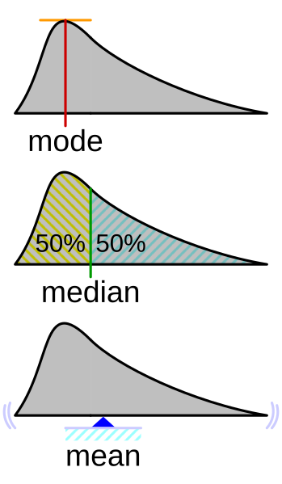
Replacing Nans/Null values
Quantitative data filled by mean
Qualitative data filled by mode
Skipping columns without missing values by using df[column].isnull().sum() == 0:
Notes:
skew of data

Slide 15
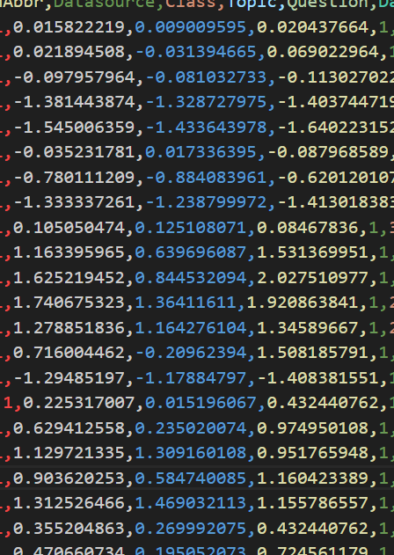
Normalizing Features
We normalize attributes that are non-categorical
['Data_Value', 'Low_Confidence_Limit', 'High_Confidence_Limit']
We use the Z-score normalization from scipy.stats
df[val] = zscore(df[val])
Notes:
skew of data

Slide 16
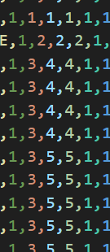
Transforming Non-numerical Data
When data is not transformed to numerical
Weka is limited
For loop through each column, check if is qualitative or quantitative
use pd.factorize(df[column])[0] + 1
Notes:
skew of data

Slide 17
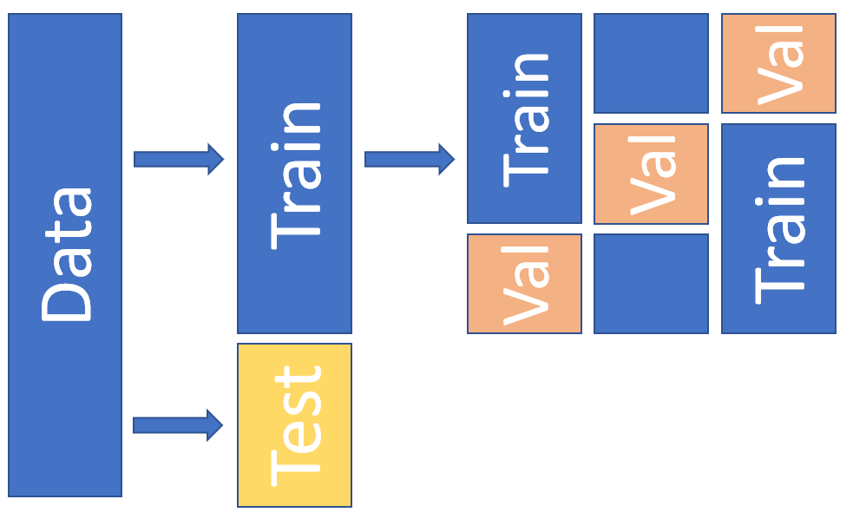
Splitting the Dataset
We will do a 70%/20%/10% split for the train and test datasets.
Use sklearn’s train_test_split to split the data with the stratify argument to ensure the ratios of the class are the same.
The lengths are 198899, 57112, and 28131 respectively. 284,142 total.
train_test_split(X_temp, y_temp, stratify=y_temp, test_size=0.33, random_state=42)
Notes:
skew of data

Slide 18
04
Attribute Selection

Slide 19
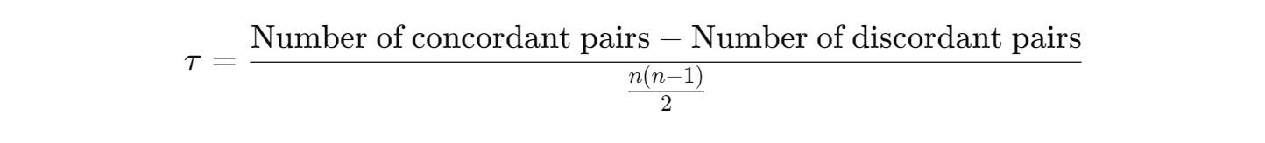
Attribute Selection Algorithms Used
Kendall Rank Correlation Coefficient
CorrelationAttributeEval
Finds correlation based on rank
Concordant Pair: (x1,y1)(x_1, y_1)(x1​,y1​) and (x2,y2)(x_2, y_2)(x2​,y2​) is concordant if it satisfies one of the following conditions:
x1>x2x_1 > x_2x1​>x2​ and y1>y2y_1 > y_2y1​>y2​
x1<x2x_1 < x_2x1​<x2​ and y1<y2y_1 < y_2y1​<y2​
Discordant Pair: A pair of observations (x1,y1)(x_1, y_1)(x1​,y1​) and (x2,y2)(x_2, y_2)(x2​,y2​) is discordant if it satisfies one of the following conditions:
x1>x2x_1 > x_2x1​>x2​ and y1<y2y_1 < y_2y1​<y2​
1<x2x_1 < x_2x1​<x2​ and y1>y2y_1 > y_2y1​>y2​
n: The total number of observations.

Slide 20
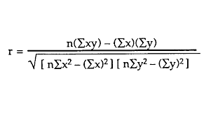
Attribute Selection Algorithms Used
Pearson’s Correlation
Subset Analysis
CorrelationAttributeEval
ranks attributes based on correlation coefficient
CfsSubsetEval
Selects attributes by:
grouping attributes as subsets
in each subset, evaluate attributes individually
choose a subset with high correlation with class but low intercorrelation
Searches with greedy-stepwise search
Notes:
Source: CfsSubsetEval
greedy stepwise search: GreedyStepwise

Slide 21
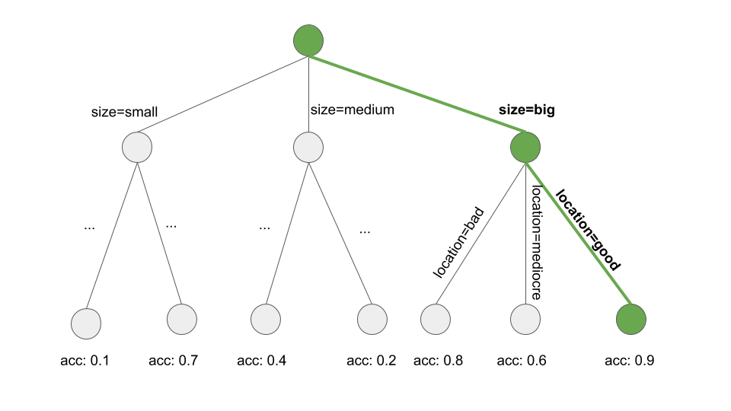
Attribute Selection Algorithms Used
Selection by OneR
Entropy/Information Gain
OneRAttributeEval
ranks attributes based on classification error from the OneR algorithm
InfoGainAttributeEval
ranks attributes based on information gained with respect to the class

Slide 22
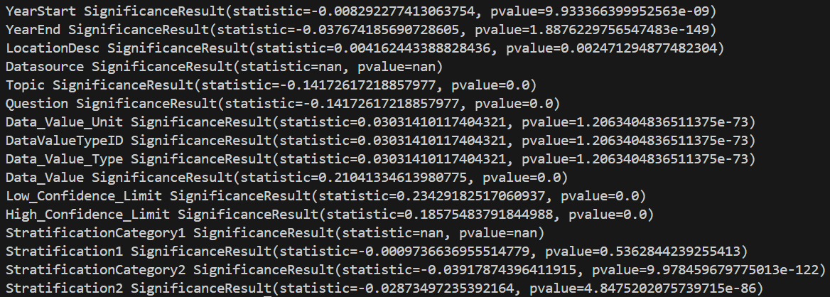
Attributes Selected: Kendall Correlation
0.10 and -0.10 as bounds
Chosen Attributes: Topic, Question, Data_Value, Low_Confidence_Limit, High_Confidence_Limit

Slide 23
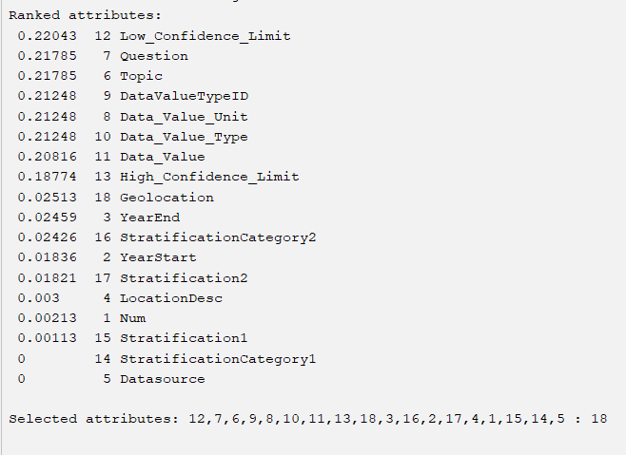
Attributes Selected: Pearson’s Correlation
cutoff = 0.20

Slide 24
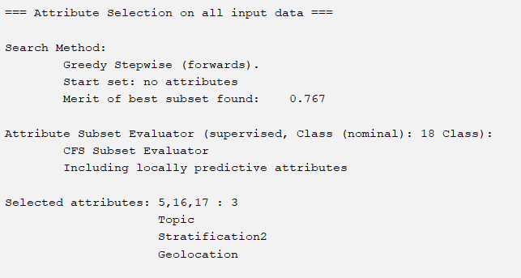
Attributes Selected: Subset Analysis

Slide 25
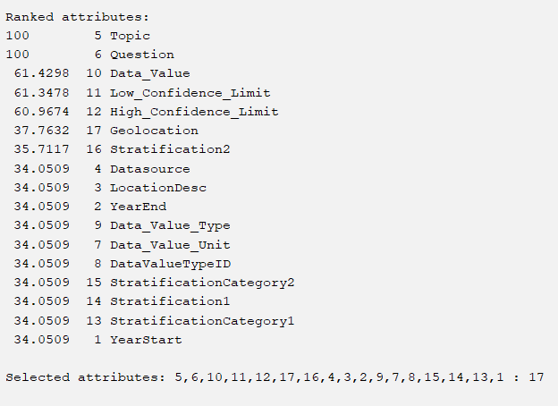
Attributes Selected: OneR
cutoff = 37.0

Slide 26
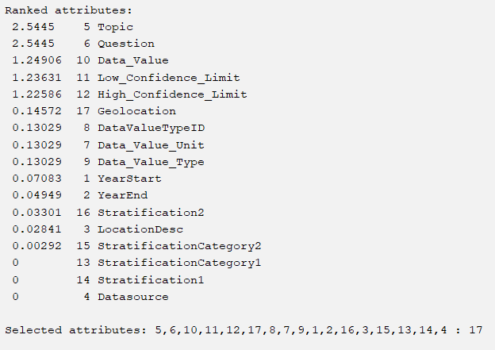
Attributes Selected: Information Gain
cutoff = 0.13

Slide 27
05
Results + Analysis

Slide 28
Classification Algorithms Used
OneR
Decision Table
Rule-based method selecting ONE rule based on the attribute with least classification error
Rule-based method that selects MULTIPLE rules based on interactions between multiple attributes
J48
Random Forest
Tree-based method based on the usage of the C4.5 algorithm to generate decision trees
Tree-based method that creates a forest of random trees

Slide 29
Att. Selection Algorithm | Classification Algorithm | Accuracy | MAE | RMSE | Precision | Recall
Kendall’s Rank (Non-Weka) | OneR | 100% | 0 | 0 | 1.0 | 1.0
 | Decision Table | 100% | 0.0002 | 0.0003 | 1.0 | 1.0
 | J48 | 100% | 0 | 0 | 1.0 | 1.0
 | Random Forest | 99.9929% | 0 | 0.0037 | 1.0 (0.99 in one category) | 1.0
Pearson’s Correlation | OneR | 100% | 0 | 0 | 1.0 | 1.0
 | Decision Table | 100% | 0 | 0 | 1.0 | 1.0
 | J48 | 100% | 0 | 0 | 1.0 | 1.0
 | Random Forest | 99.9964% | 0.0001 | 0.0031 | 1.0 | 1.0
Notes:
rule based models performed well overall

Slide 30
Att. Selection Algorithm | Classification Algorithm | Accuracy | MAE | RMSE | Precision | Recall
Subset Analysis | OneR | 100% | 0 | 0 | 1.0 | 1.0
 | Decision Table | 100% | 0.0002 | 0.0003 | 1.0 | 1.0
 | J48 | 100% | 0 | 0 | 1.0 | 1.0
 | Random Forest | 100% | 0.0002 | 0.0011 | 1.0 | 1.0
OneR Algorithm | OneR | 100% | 0 | 0 | 1.0 | 1.0
 | Decision Table | 100% | 0.002 | 0.003 | 1.0 | 1.0
 | J48 | 100% | 0 | 0 | 1.0 | 1.0
 | Random Forest | 99.9929% | 0.0001 | 0.004 | 1.0 (0.99 in one class) | 1.0
Notes:
same trends generally

Slide 31
Att. Selection Algorithm | Classification Algorithm | Accuracy | MAE | RMSE | Precision | Recall
Information Gain | OneR | 100% | 0 | 0 | 1.0 | 1.0
 | Decision Table | 100% | 0.0002 | 0.0003 | 1.0 | 1.0
 | J48 | 100% | 0 | 0 | 1.0 | 1.0
 | Random Forest | 99.9929% | 0.0001 | 0.0039 | 1.0 (0.99) in a class | 1.0

Slide 32
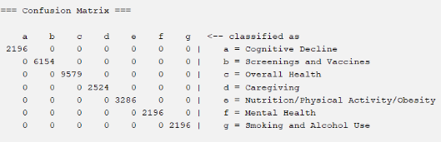
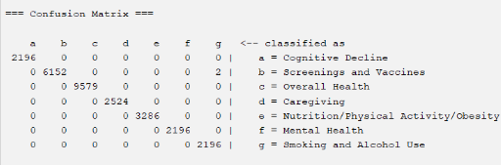
Confusion Matrix Comparisons
A perfect confusion matrix
Subset Analysis with OneR
Confusion matrix with some errors
Kendall’s Correlation with Random Forest

Slide 33
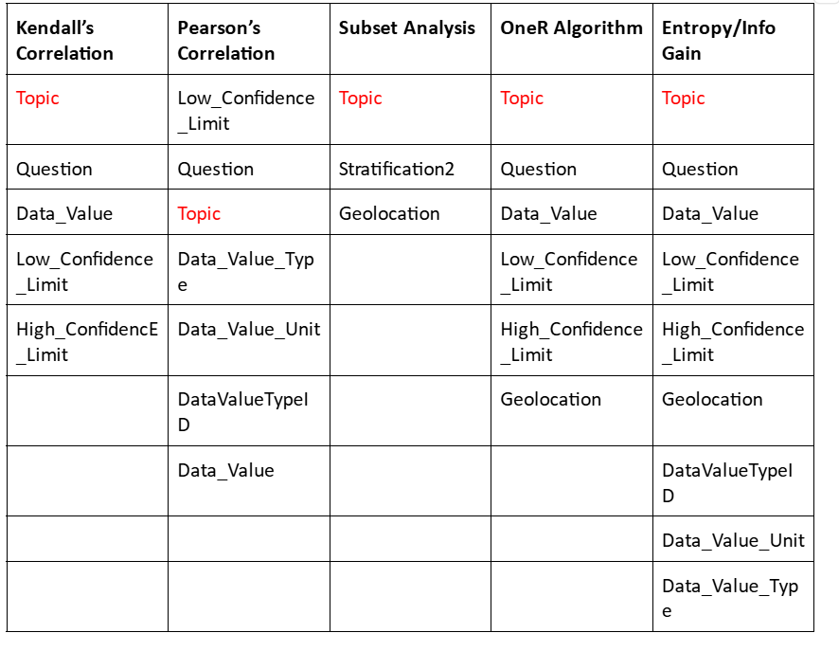
Why did most algorithms perform perfectly?
Notes:
frequency of topic and question

Slide 34
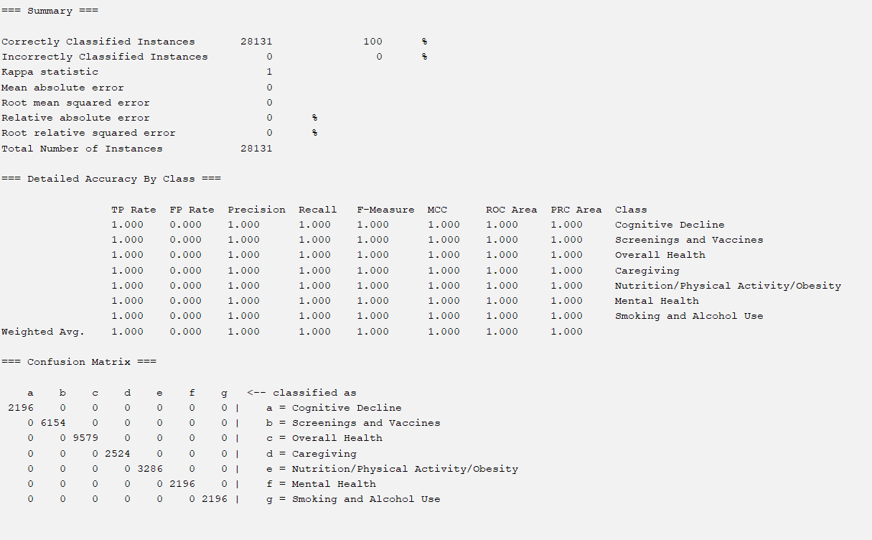
What if we remove ‘Topic’?
From the Kendall Rank-selected attributes with OneR:

Slide 35
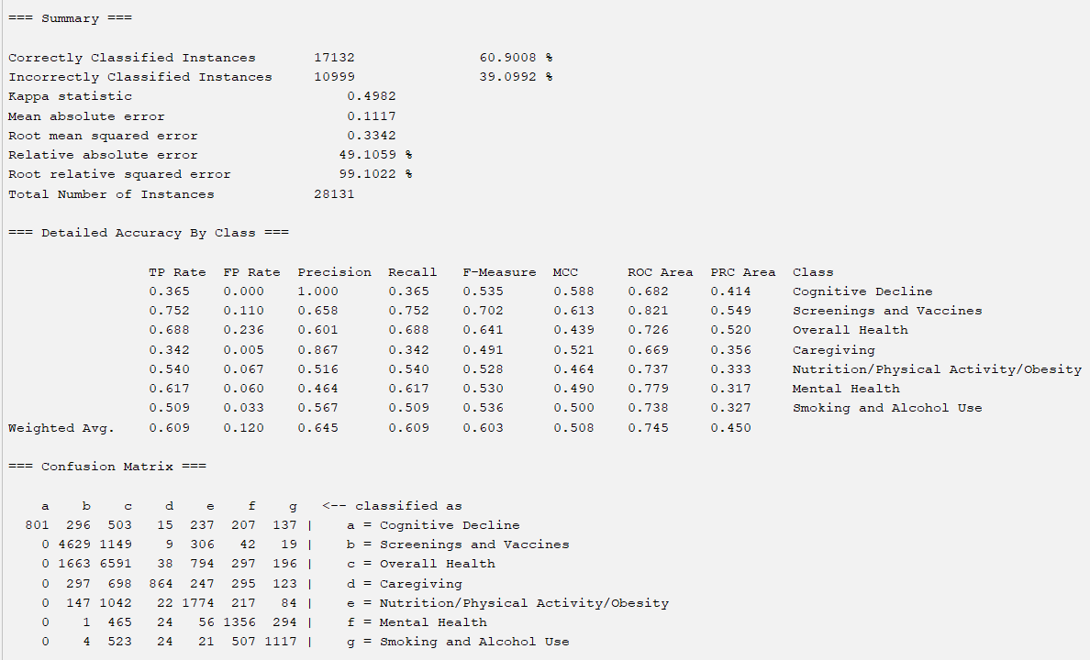
What if we ALSO remove ‘Question’?
From the Kendall Rank-selected attributes with OneR:
Notes:
discuss significance of topic and question in context

Slide 36
Att. Selection Algorithm | Classification Algorithm | Accuracy | MAE | RMSE | Precision | Recall
Kendall’s Rank (Non-Weka) | OneR | 60.9002% | 0.1117 | 0.3342 | 0.645 | 0.609
 | Decision Table | 62.2445% | 0.1254 | 0.2505 | 0.626 | 0.622
 | J48 | 62.2516% | 0.1193 | 0.2646 | 0.621 | 0.623
 | Random Forest | 61.5655% | 0.1153 | 0.2705 | 0.615 | 0.616
Pearson’s Correlation | OneR | 60.9008% | 0.1117 | 0.3342 | 0.645 | 0.609
 | Decision Table | 63.8904% | 0.1203 | 0.2447 | 0.649 | 0.639
 | J48 | 63.318% | 0.1172 | 0.2556 | 0.632 | 0.633
 | Random Forest | 61.5691% | 0.1144 | 0.2683 | 0.616 | 0.616
Notes:
rule based models performed well overall

Slide 37
Att. Selection Algorithm | Classification Algorithm | Accuracy | MAE | RMSE | Precision | Recall
Subset Analysis | OneR | 37.7022% | 0.178 | 0.4219 | ? | 0.377
 | Decision Table | 39.085% | 0.2152 | 0.3279 | ? | 0.391
 | J48 | 39.085% | 0.2175 | 0.3287 | ? | 0.391
 | Random Forest | 39.117% | 0.2151 | 0.3282 | ? | 0.391
OneR Algorithm | OneR | 66.0268% | 0.1117 | 0.3342 | 0.645 | 0.609
 | Decision Table | 66.0268% | 0.1237 | 0.243 | 0.661 | 0.660
 | J48 | 67.5767% | 0.1026 | 0.2588 | 0.675 | 0.676
 | Random Forest | 68.405% | 0.1017 | 0.2391 | 0.683 | 0.684
Notes:
rule based models performed well overall

Slide 38
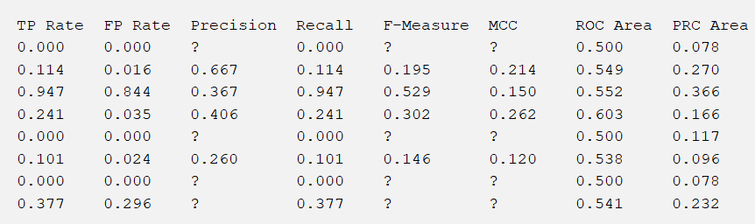
Explanation of Subset Analysis

Slide 39
Att. Selection Algorithm | Classification Algorithm | Accuracy | MAE | RMSE | Precision | Recall
Information Gain | OneR | 60.9008% | 0.1117 | 0.3342 | 0.645 | 0.609
 | Decision Table | 66.9724% | 0.1218 | 0.24 | 0.672 | 0.670
 | J48 | 68.2663% | 0.1003 | 0.2554 | 0.682 | 0.683
 | Random Forest | 68.6716% | 0.1008 | 0.2363 | 0.686 | 0.687
Notes:
rule based models performed well overall

Slide 40
We choose Information Gain Attribute Selection with Random Forest classification to be our best model.

Slide 41
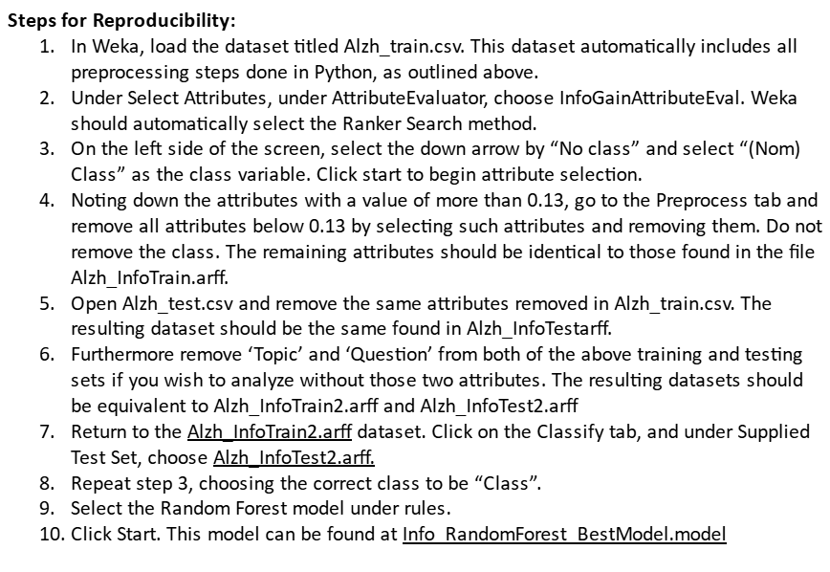

Slide 42
06
Conclusion

Slide 43

Reflection
Understanding class variable
Stratified sampling in code
Dealing with qualitative data
Being mindful of data
Notes:
skew of data

Slide 44

Next Steps
Improve preprocessing.
use min-max and decimal scaling to replicate the exact scale.
Further analysis of performance, model, and feature selector.
possible investigation of intercorrelation between attributes
Notes:
skew of data

Slide 45
References
Alzheimer's Association. (2023). 2023 Alzheimer’s Disease Facts and Figures. Alzheimer’s & Dementia, 19(4), 1598–1695. https://doi.org/10.1002/alz.13016
CDC Division of Population Health. (2024). Alzheimer’s Disease and Healthy Aging Data | Data | Centers for Disease Control and Prevention. Chronicdata.cdc.gov. https://chronicdata.cdc.gov/Healthy-Aging/Alzheimer-s-Disease-and-Healthy-Aging-Data/hfr9-rurv/about_data
CfsSubsetEval. (n.d.). Weka.sourceforge.io. https://weka.sourceforge.io/doc.dev/weka/attributeSelection/CfsSubsetEval.html
GeeksForGeeks. (2020, May 15). Python | Kendall Rank Correlation Coefficient. GeeksforGeeks. https://www.geeksforgeeks.org/python-kendall-rank-correlation-coefficient/
GreedyStepwise. (2022, January 28). Sourceforge.io. https://weka.sourceforge.io/doc.dev/weka/attributeSelection/GreedyStepwise.html
https://www.health.com/condition/alzheimers-overview. (2022, August 15). What Is Alzheimer’s Disease? Health. https://www.health.com/condition/alzheimers-overview

